Slide 2


Reactions, particles, and collisions
Reactions take place when particles collide with a certain amount of energy.
The minimum amount of energy needed for the particles to react is called the activation energy, and it is different for each reaction.
The rate of a reaction depends on two things:
the frequency of collisions between particles
the energy with which particles collide.
If particles collide with less energy than the activation energy, they will not react. The particles will just bounce off each other.
Notes:
Teacher notes
See the ‘Energy Transfer’ presentation for more information on activation energy.

Slide 4
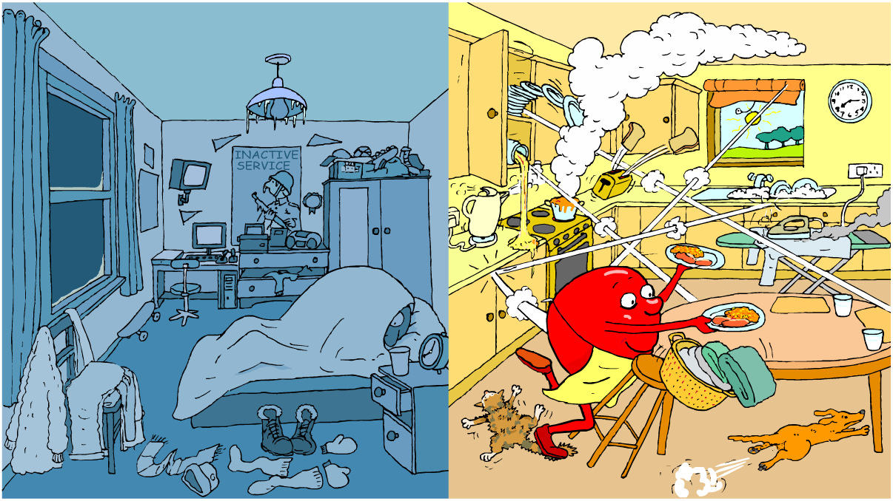
Temperature & Collisions
How does temperature affect the rate of particle collision?

Slide 5

Effect of temperature on rate
The higher the temperature, the faster the rate of a reaction. In many reactions, a rise in temperature of 10 °C causes the rate of reaction to approximately double.
Why does increased temperature increase the rate of reaction?
At a higher temperature, particles have more energy. This means they move faster and are more likely to collide with other particles.
When the particles collide, they do so with more energy, and so the number of successful collisions increases.

Slide 6

Temperature & Particle Collisions
Notes:
Teacher notes
This simulation illustrates how increasing the temperature increases the number of collisions between particles.

Slide 8
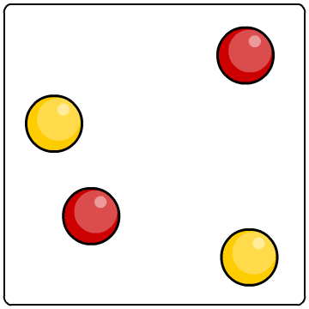
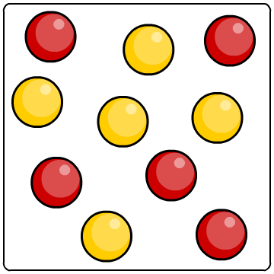
Effect of concentration on rate of reaction
The higher the concentration of a dissolved reactant, the faster the rate of a reaction.
Why does increased concentration increase the rate of reaction?
At a higher concentration, there are more particles in the same amount of space. This means that the particles are more likely to collide and therefore more likely to react.
lower concentration
higher concentration

Slide 9
Concentration and particle collisions
Notes:
Teacher notes
This simulation illustrates how increasing the concentration increases the number of collisions between particles.

Slide 11
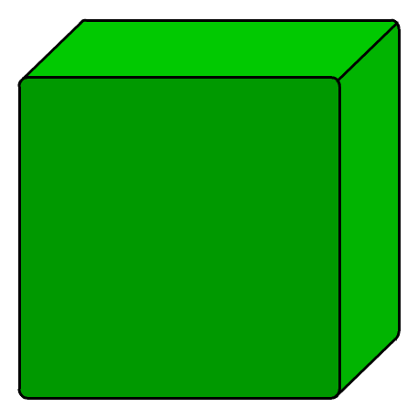
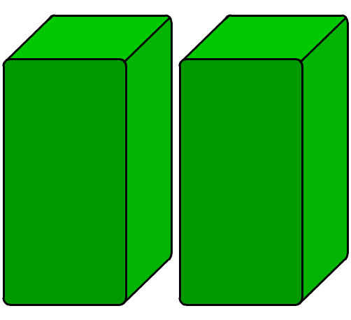
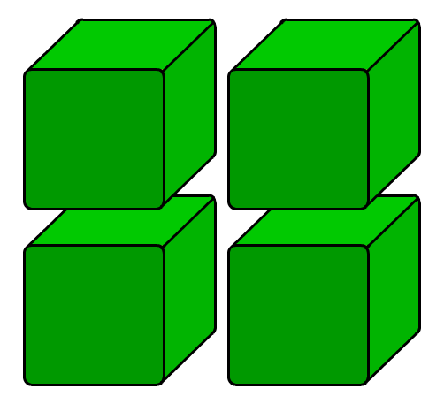
Effect of surface area on rate of reaction
Any reaction involving a solid can only take place at the surface of the solid.
If the solid is split into several pieces, the surface area increases. What effect will this have on rate of reaction?
low surface area
high surface area
This means that there is an increased area for the reactant particles to collide with.
The smaller the pieces, the larger the surface area. This means more collisions and a greater chance of reaction.

Slide 12
Surface area and particle collisions
Notes:
Teacher notes
This simulation illustrates how increasing the surface area increases the number of collisions between particles and solid reactants

Slide 13
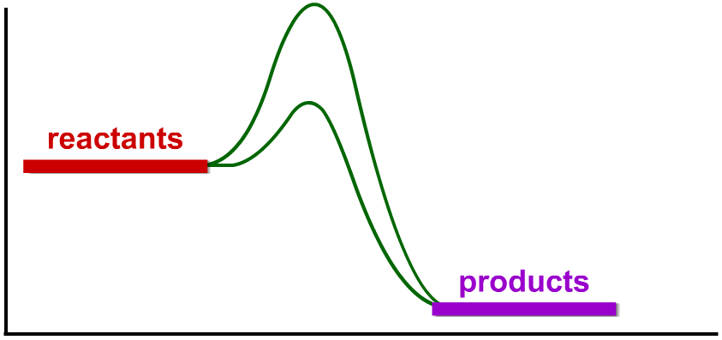
What are catalysts?
Catalysts are substances that change the rate of a reaction without being used up in the reaction.
Catalysts never produce more product – they just produce the same amount more quickly.
E_{a} without
catalyst
Different catalysts work in different ways, but most lower the reaction’s activation energy.
energy (kJ)
E_{a} with
catalyst
reaction (time)
Notes:
Teacher notes
See the ‘Energy Transfer’ presentation for more information on activation energy.

Slide 14
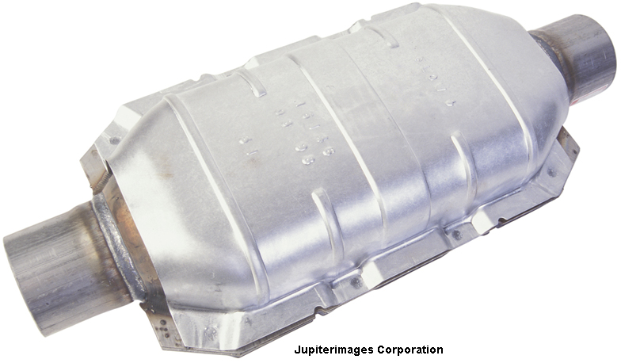
Everyday catalysts
Many catalysts are transition metals or their compounds. For example:
Nickel is a catalyst in the production of margarine (hydrogenation of vegetable oils).
Iron is a catalyst in the production of ammonia from nitrogen and hydrogen (the Haber process).
Platinum is a catalyst in the catalytic converters of car exhausts. It catalyzes the conversion of carbon monoxide and nitrogen oxide into the less polluting carbon dioxide and nitrogen.
Notes:
Photo credit: © 2007 Jupiterimages Corporation
Teacher notes
See the ‘Reversible Reactions’ presentation for more information on the Haber process.

Slide 15
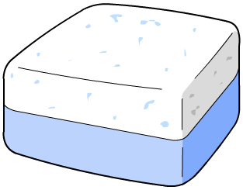

Catalysts in industry
Why are catalysts so important for industry?
Products can be made more quickly, saving time and money.
Catalysts reduce the need for high temperatures, saving fuel and reducing pollution.
Catalysts are also essential for living cells. Biological catalysts are special types of protein called enzymes.
Notes:
Teacher notes
See the ‘Enzymes’ Biology presentation for more information on enzymes as catalysts and their use in industrial processes.

Slide 17
Anagrams

Slide 18
Rates of reaction: summary
Notes:
Teacher notes
This completing sentences activity provides the opportunity for some informal assessment of students’ understanding of rates of reaction.

Slide 19
Multiple-choice quiz
Notes:
Teacher notes
This multiple-choice quiz could be used as a plenary activity to assess students’ understanding of rates of reaction. The questions can be skipped through without answering by clicking “next”. Students could be asked to complete the questions in their books and the activity could be concluded by the completion on the IWB.

