Slide 1
Classifying Matter: Elements, Compounds, and Mixtures

Slide 3
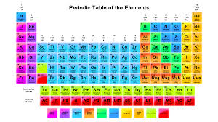
Elements
pure substance that cannot be separated into simpler substances by physical or chemical means.

Slide 4
Compounds
Pure substance composed of two or more different elements joined by chemical bonds.
Made of elements in a specific ratio
that is always the same
Has a chemical formula
Can only be separated by
chemical means, not physically
H₂O
NaCl
CO₂

Slide 5
Mixtures
A combination of two or more pure substances that are not chemically combined.
substances held together by physical forces, not chemical
No chemical change takes place
Each item retains its properties
in the mixture
They can be separated physically

Slide 6
Can you identify the following?
You will be shown a series of photos. Tell if each photo represents an item composed of an element, compound, or mixture.
Review:
An element contains just one type of atom.
A compound contains two or more different atoms chemically joined together.
A mixture contains two or more different substances that are only physically joined together, not chemically.
A mixture can contain both elements and compounds.

Slide 7
What is an ELEMENT?
A substance composed of a single kind of atom.
Cannot be broken down into another substance by chemical or physical means.

Slide 8
What is a COMPOUND?
A substance in which two or more different elements are CHEMICALLY bonded together.

Slide 9
What is a MIXTURE?
Two or more substances that are mixed together but are NOT chemically bonded.

Slide 10
Element, Compound or Mixture?

Slide 11
Element, Compound or Mixture?

Slide 12
Element, Compound or Mixture?

Slide 13
Element, Compound or Mixture?

Slide 14
Element, Compound or Mixture?

Slide 15
Element, Compound or Mixture?

Slide 16
Element, Compound, or Mixture?
Rocks

Slide 17
Element, Compound, or Mixture?
Rocks

Slide 18
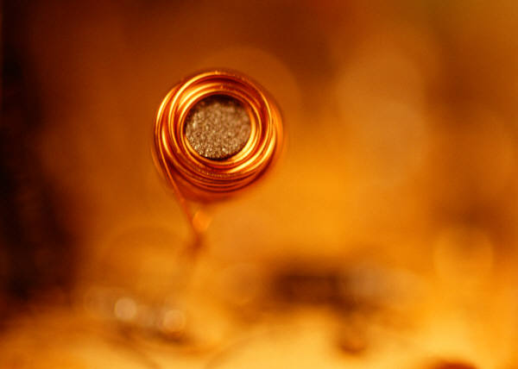
Element, Compound, or Mixture?
Copper

Slide 19
Element, Compound, or Mixture?
Copper
Cu

Slide 20
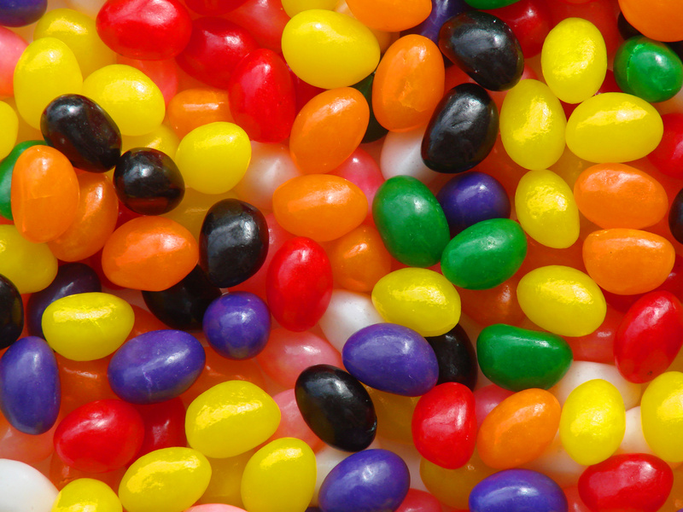
Element, Compound, or Mixture?
Jelly Beans

Slide 21
Element, Compound, or Mixture?
Jelly Beans

Slide 22
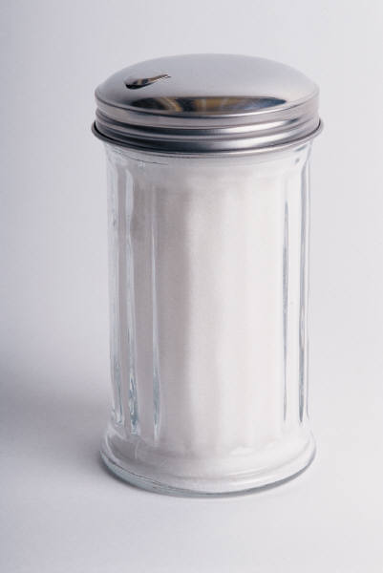
Element, Compound, or Mixture?
Sugar

Slide 23
Element, Compound, or Mixture?
Sugar
C₆H₁₂O₆

Slide 24
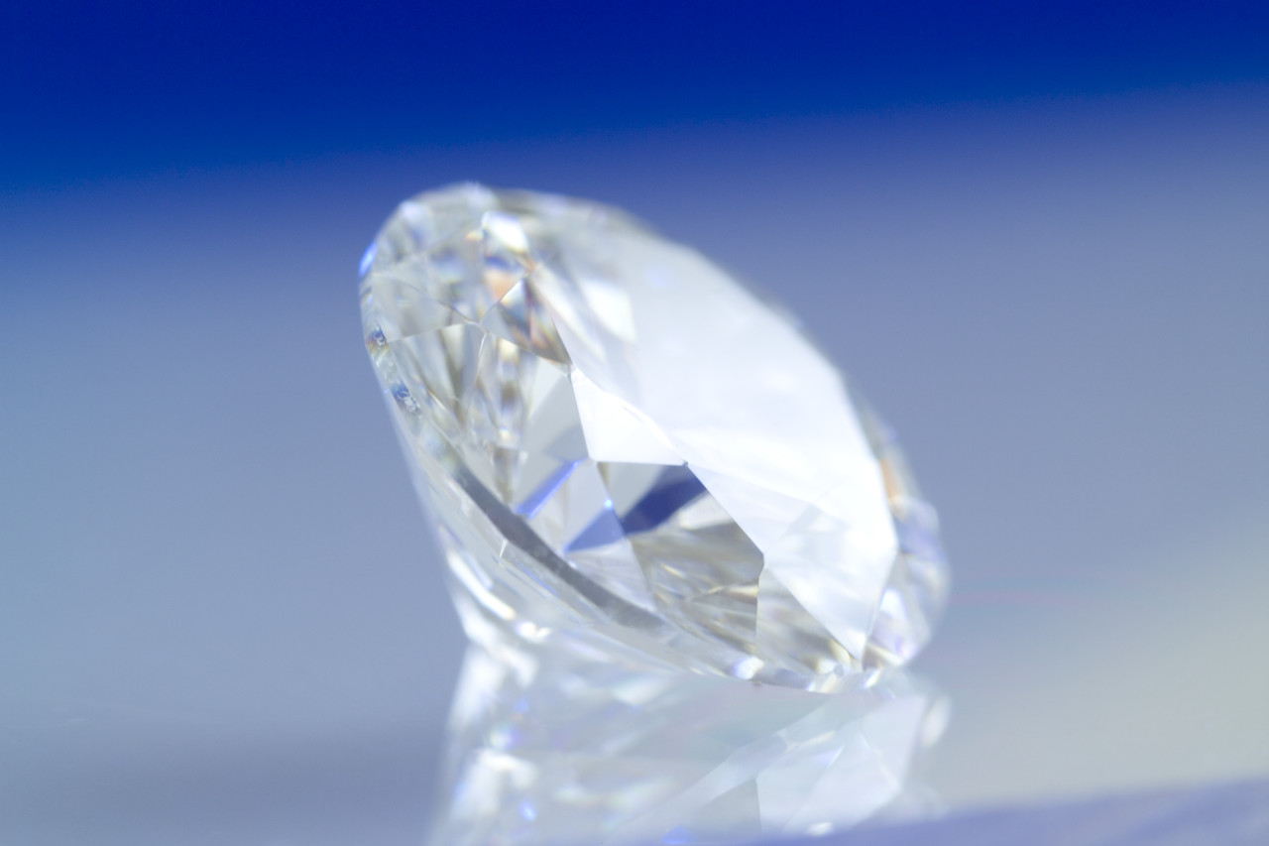
Element, Compound, or Mixture?
Diamond

Slide 25
Element, Compound, or Mixture?
Diamond
C

Slide 26
Element, Compound, or Mixture?
Tea

Slide 27
Element, Compound, or Mixture?
Tea

Slide 28
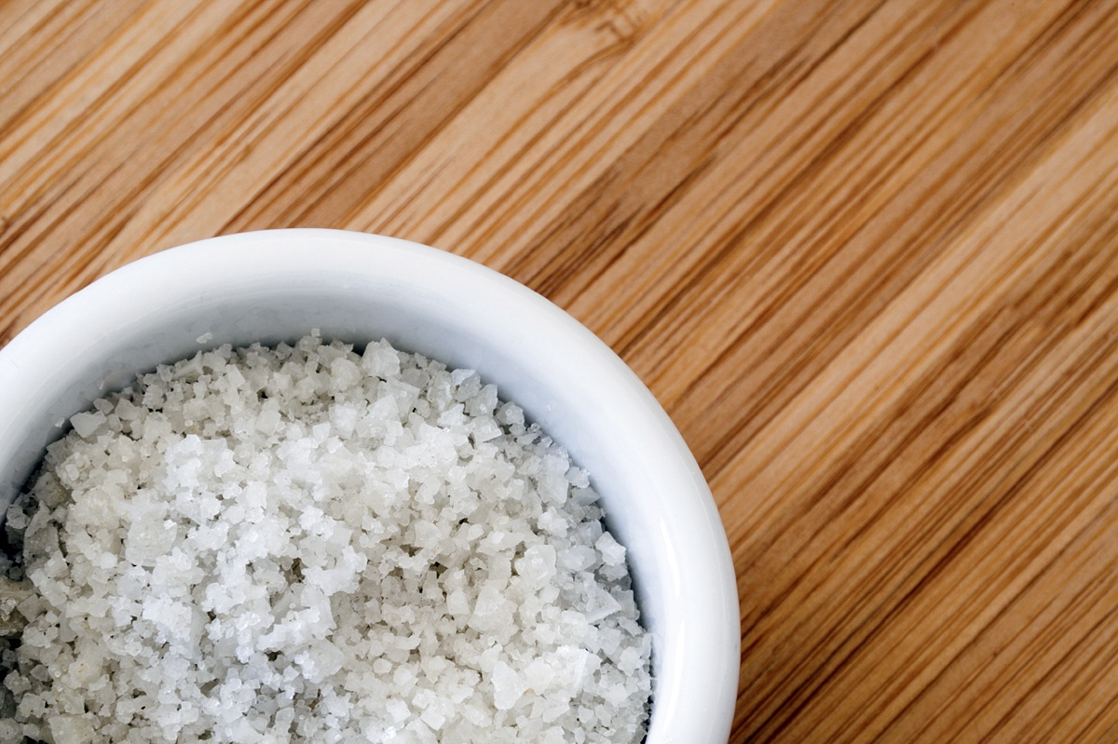
Element, Compound, or Mixture?
Salt

Slide 29
Element, Compound, or Mixture?
NaCl
Salt

Slide 30
Element, Compound, or Mixture?
Neon Gas

Slide 31
Element, Compound, or Mixture?
Ne
Neon Gas

Slide 32
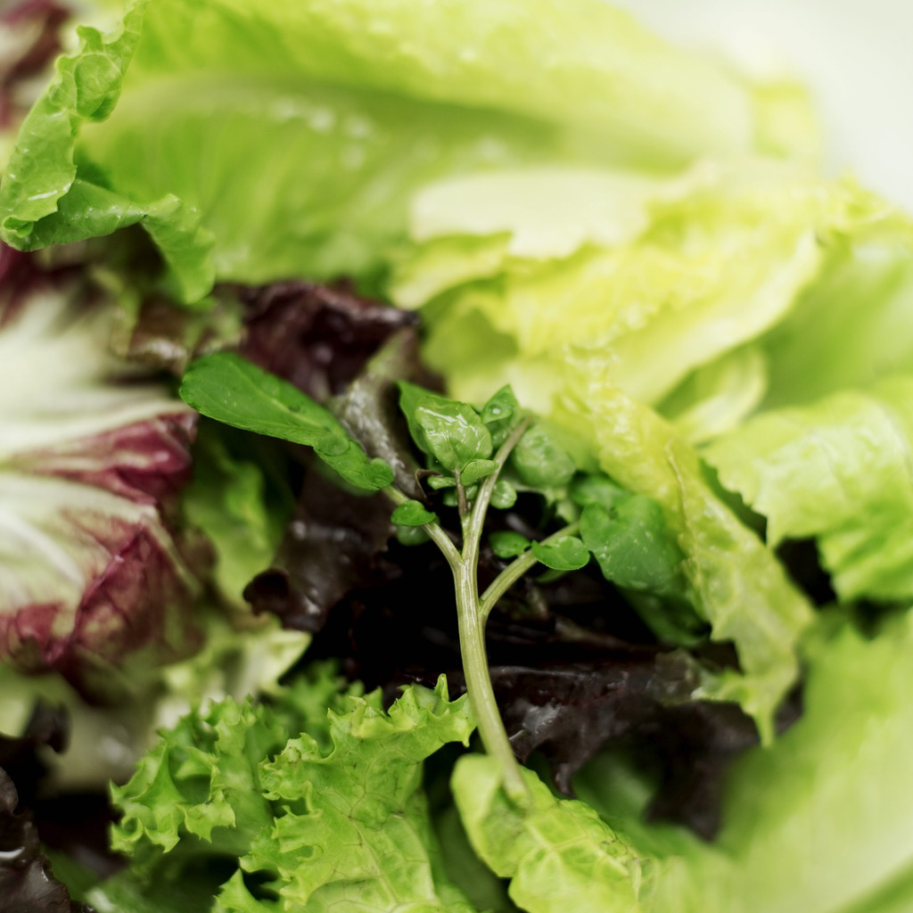
Element, Compound, or Mixture?
Salad

Slide 33
Element, Compound, or Mixture?
Salad

Slide 34
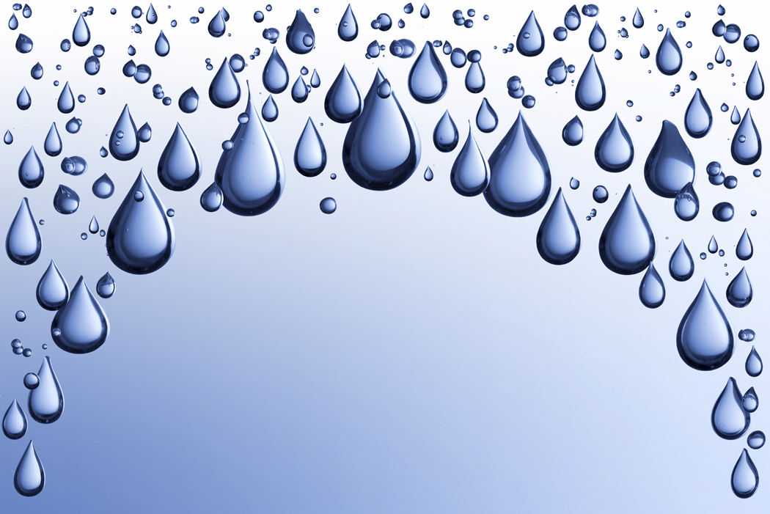
Element, Compound, or Mixture?
Pure Water

Slide 35
Element, Compound, or Mixture?
Pure Water
H₂O

Slide 36
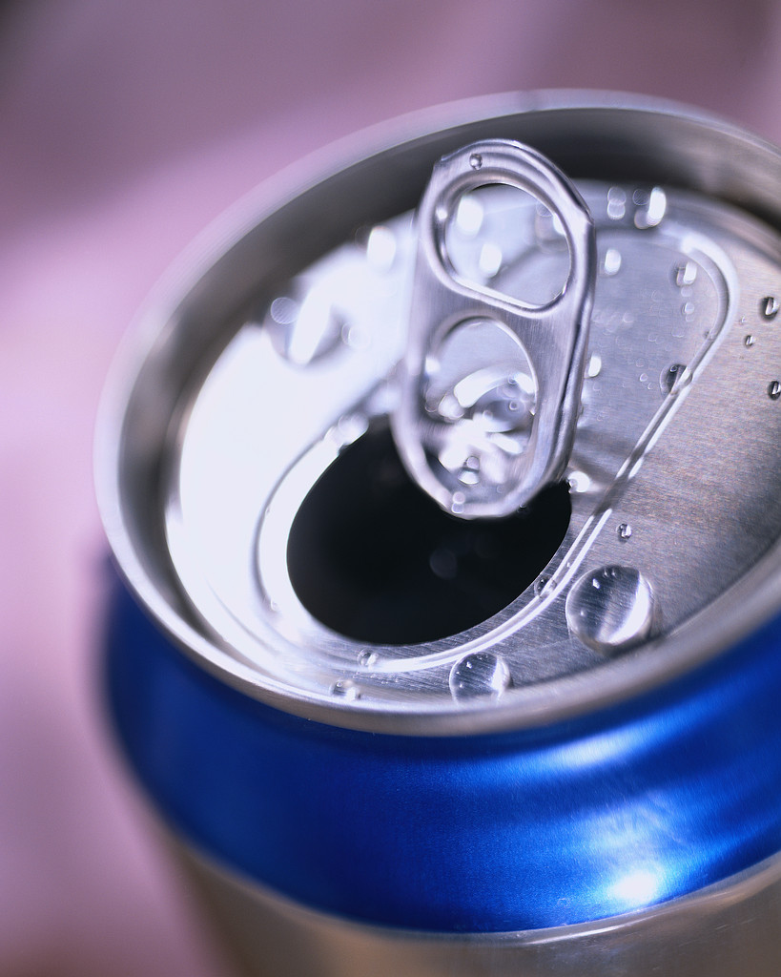
Element, Compound, or Mixture?
Aluminum

Slide 37
Element, Compound, or Mixture?
Aluminum
Al

Slide 38
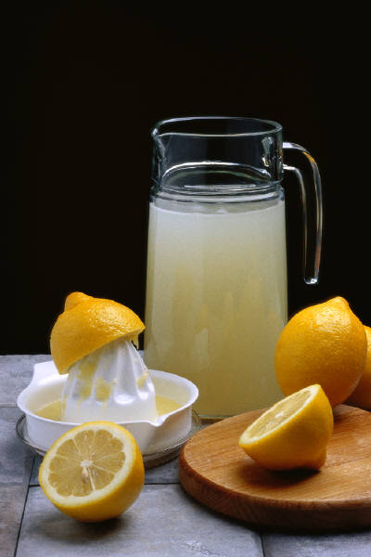
Element, Compound, or Mixture?
Lemonade

Slide 39
Element, Compound, or Mixture?
Lemonade

Slide 40
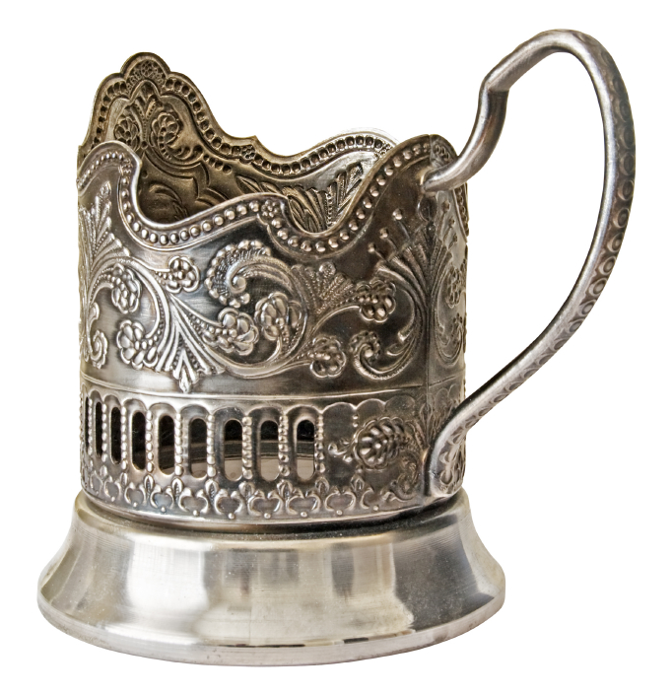
Element, Compound, or Mixture?
Silver

Slide 41
Element, Compound, or Mixture?
Silver
Ag

Slide 42
Element, Compound, or Mixture?
Sand

Slide 43
Element, Compound, or Mixture?
Sand

Slide 44
Notes
Detailed notes are located at:
http://www.middleschoolscience.com/elements-compounds-mixtures-notes-isn.pdf
Flow Chart:
http://www.middleschoolscience.com/matter-flow-chart-isn.pdf

