Slide 1
Bohr models
They aren’t just bohr-ring drawings!

Slide 2
Bohr models-a simple way to draw an atom
Bohr models are a way of showing the electrons in an atom.
Electrons are arranged in energy levels. In actual atoms, those energy levels are clouds of crazy shapes where the electrons are likely to be found.
Bohr models show the electron energy levels in nice, neat, easy to draw circles.

Slide 3
The Nucleus (Put the number of protons and neutrons in your nucleus)
Draw a circle in the middle of your drawing to represent the nucleus. Write the number of protons and neutrons in the nucleus.
___P
___N

Slide 4
1st energy level (2 electrons)
Draw the first ring of electrons around the nucleus. Only 2 electrons can fit in this energy level
2 e
___P
___N

Slide 5
2nd energy level (8 electrons)
Draw the second ring of electrons around the nucleus. Only 8 electrons can fit in this energy level
___P
___N
2 e
8 e

Slide 6
3rd & 4th energy levels (18 electrons in the 3rd, 32 electrons in the 4th
Draw the next 3rd and 4th ring of electrons around the nucleus. 18 electrons can fit in the 3rd energy level and 32 electrons can fit in the 4the energy level
___P
___N
2 e
8 e
18 e
32 e

Slide 7
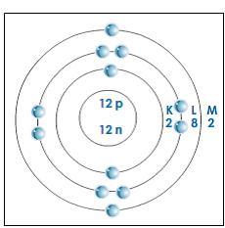
Magnesium Bohr Model
*Magnesium has 12 electrons
*Put 2 dots on the 1st ring.
*Put 8 dots in the 2nd ring.
*Put the rest of the electrons in the 3rd ring.

Slide 8
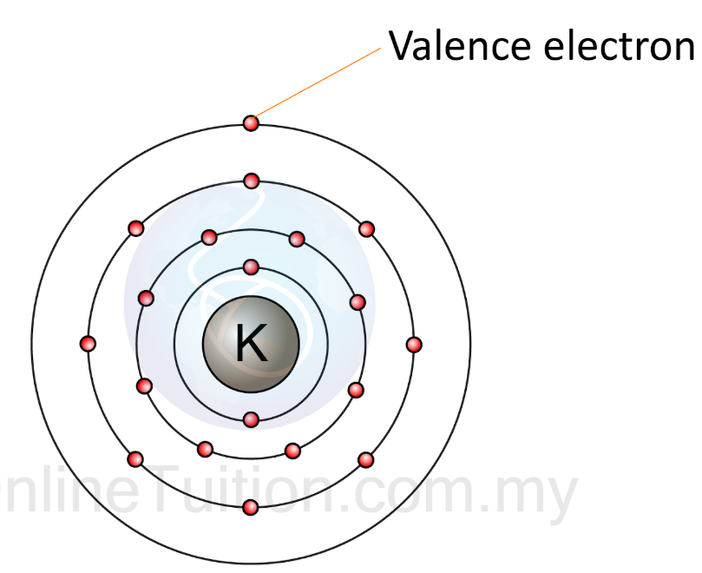
Valence Electrons
are the electrons in the outer shell of an atom. The valence electrons are the ones involved in forming bonds to adjacent atoms. Therefore, the number of VE is important for determining the number of bonds an atom will form.

