Slide 1
Atomic Structure

Slide 2
What is an atom?
Atom: the smallest unit of matter that retains the identity of the substance

Slide 3
Atomic Structure
Atoms are composed of 2 regions:
Nucleus: the center of the atom that contains the mass of the atom
Electron cloud: region that surrounds the nucleus that contains most of the space in the atom
Nucleus
Electron Cloud

Slide 4
V. How do these particles interact?
Protons and neutrons live compacted in the tiny positively charged nucleus accounting for most of the mass of the atom
The negatively charged electrons are small and have a relatively small mass but occupy a large volume of space outside the nucleus

Slide 5
What’s in the Nucleus?
The nucleus contains 2 of the 3 subatomic particles:
Protons: positively charged subatomic particles
Neutrons: neutrally charged subatomic particles

Slide 6
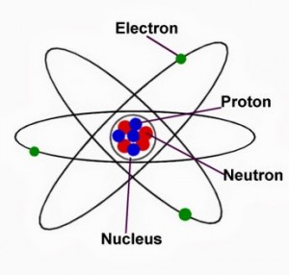
What’s in the Electron Cloud?
The 3rd subatomic particle resides outside of the nucleus in the electron cloud
Electron: the subatomic particle with a negative charge and relatively no mass

Slide 7
How do the subatomic particles balance each other?
In an atom:
The protons = the electrons
If 20 protons are present in an atom then 20 electrons are there to balance the overall charge of the atom—atoms are naturally neutral
The neutrons have no charge; therefore they do not have to equal the number of protons or electrons

Slide 8
What does the information in the box tell me?
9
F
Fluorine
19.00
Atomic Number = # of protons # of electrons
Element Symbol
Atomic Mass
= # of protons + neutrons

Slide 9
So how do we calculate the number of neutrons?
The Number of Neutrons =
The Atomic Mass – Atomic Number
(Bottom Number - Top Number)

